Slide 1


PH Qualifying seminar at LONDON 2022:
A short summary of the judging criteria used to judge Postal History Exhibits
FIP Commission for Postal History
By Henrik Mouritsen, RDP
Updated February 2022

Slide 2
The judging criteria used to judge postal history exhibits
Treatment 20
Philatelic Importance 10
Personal Study and Research 35
Condition and Rarity 30
Presentation 5

Slide 3
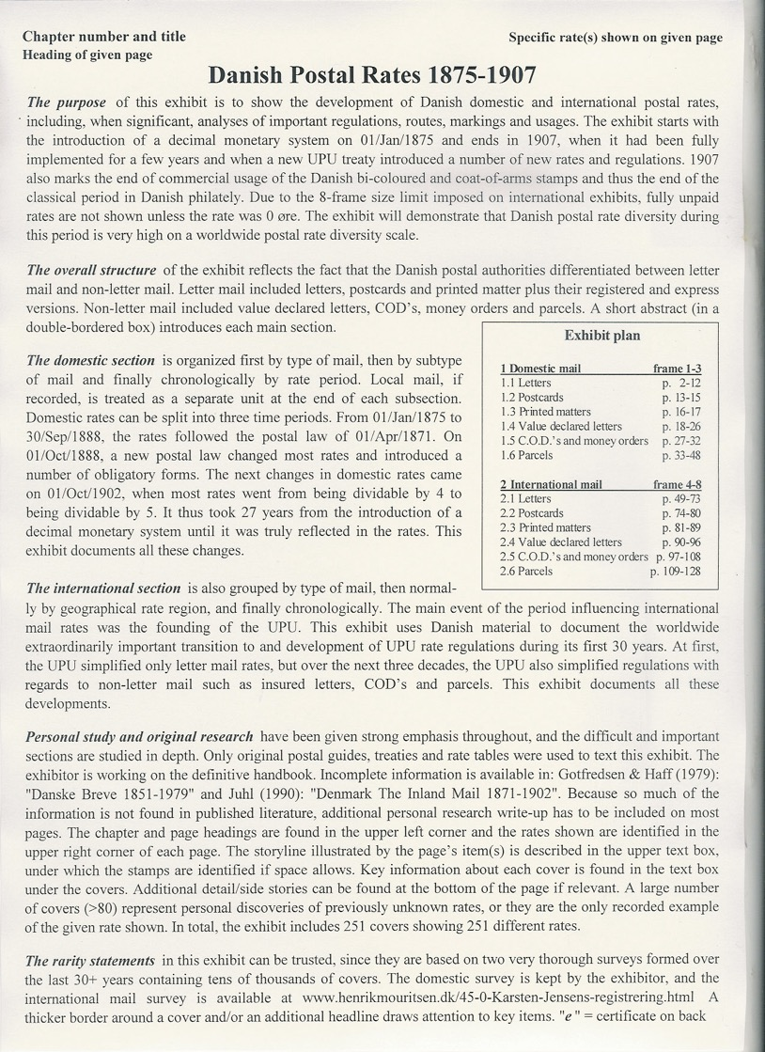

Slide 4
Treatment
Treatment is defined as the development, completeness and correctness of the material shown.

Slide 5
Treatment
Is there agreement between the title, the plan, and the content of the exhibit?
Does the exhibitor tell a well connected, structured, complete and balanced story in the exhibit and on the pages?
Is there a close connection between the story and the material shown, and does each item help progress the story/subject?
Does the story/theme flow smoothly from page to page and item to item?

Slide 6
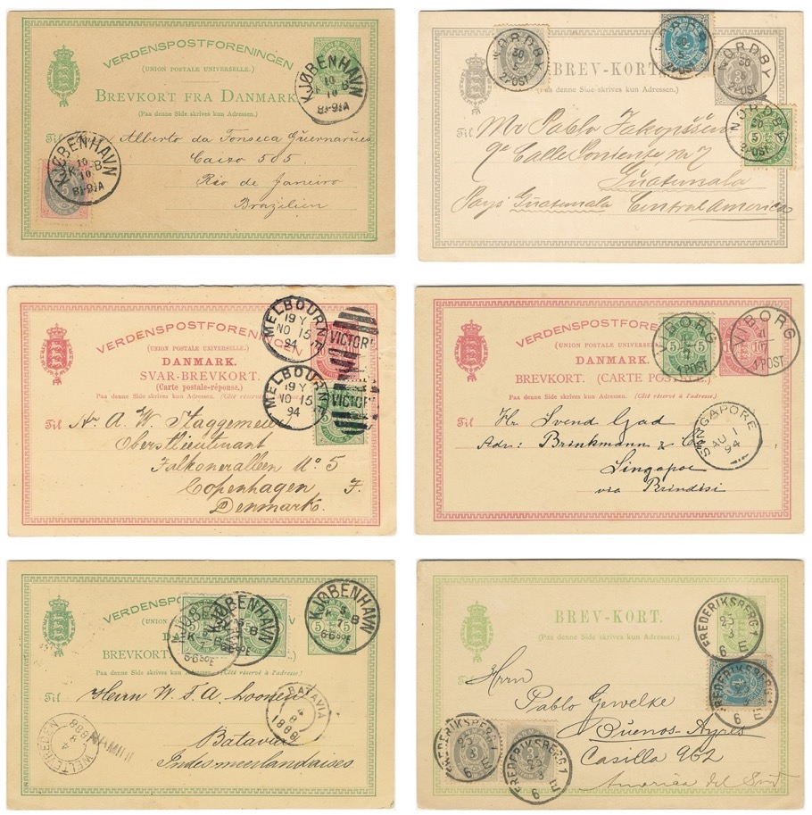
NO duplication!!!

Slide 8
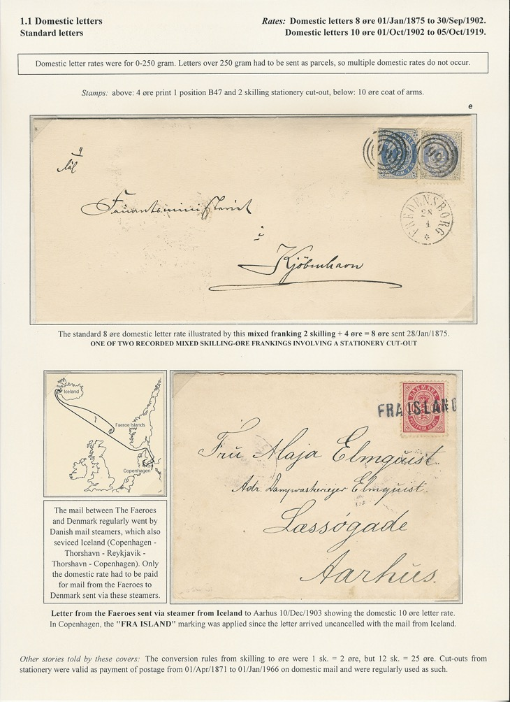
MUST KNOW
information:
Chapter # and title
Page Heading (type of mail)
Rates shown on present page

Slide 9
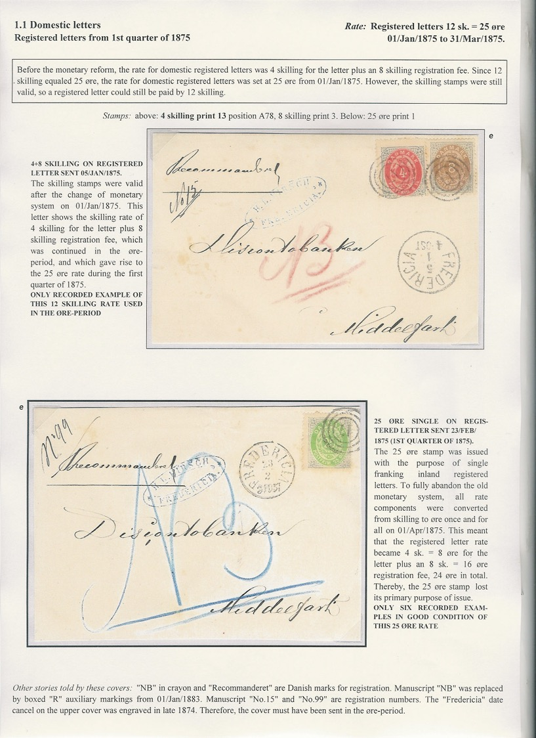

Slide 10
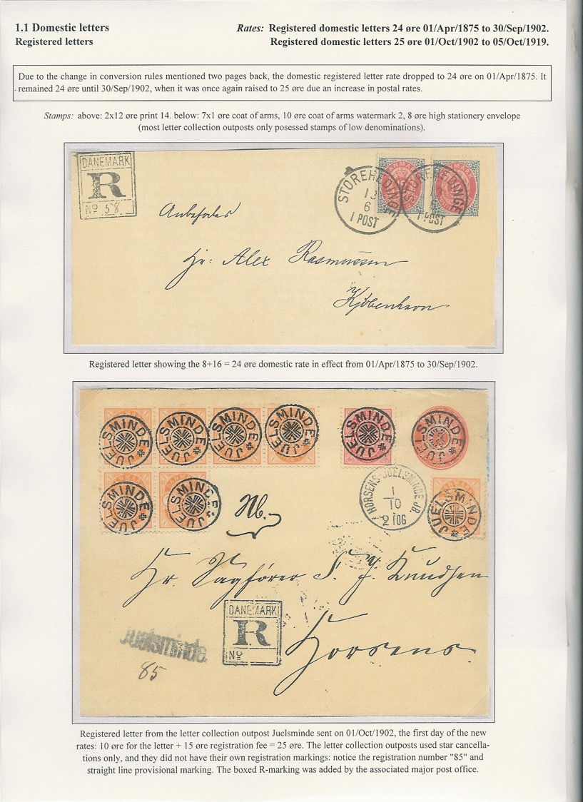

Slide 12
Treatment points
Nice to know
information:
Continuous story line. (can be read like a book through the exhibit)

Slide 13
Importance

Slide 14
The most important areas in postal history are:
Subjects illustrating important developments relevant to the postal service of the World
The introduction of organized mail.
The introduction of adhesives and the associated reductions in postal rates.
The introduction of UPU rates and regulations.
Mail-handling during World War I or II.
The introduction of automated mail sorting

Slide 15
The “old” way importance was judged
Problem: only the title was judged, not the exhibit.
An exhibit “The introduction of the world’s first postage stamp” (GB line-engraved) got 10 points, no matter how mediocre it was.
An exhibit of “modern” material got 7 points or less, no matter how good it was.
An exhibit of a smaller country got 7-8 points or less, no matter how good it was.

Slide 16
The old (still current) guidelines:
The importance of an exhibit will be gauged in relation to the general postal history of the country, area or subject shown, and to philately in general or importance to history, mankind or geographic area with respect to sub-class 2C.
Notes:
Let me start this presentation with a somewhat provocative statement:
The perfect treatment
can only be achieved
if you own a large proportion
of the best material
This statement may calm those colleagues among us, who may think that the emphasis on treatment in exhibiting has gone too far, and that what matters is material, material, material…
The good news for us all is that excellent treatment and the need for great material goes hand in hand!
The bad news to what I call the treatment-above-all camp is that treatment alone should not be able to bring an exhibit to the FIP gold or large gold medal level!
The bad news to the material-material-material camp is that great material alone should also no longer be able to get a FIP large gold medal without good treatment!
So since we need the best material to make the best possible treatment, ambitious exhibitors should consider the following points in their planning:

Slide 17
The new harmonized guidelines:
The "importance" of an exhibit is determined by both the significance of the actual exhibit in relation to the subject chosen and the overall significance of that subject.
Notes:
Let me start this presentation with a somewhat provocative statement:
The perfect treatment
can only be achieved
if you own a large proportion
of the best material
This statement may calm those colleagues among us, who may think that the emphasis on treatment in exhibiting has gone too far, and that what matters is material, material, material…
The good news for us all is that excellent treatment and the need for great material goes hand in hand!
The bad news to what I call the treatment-above-all camp is that treatment alone should not be able to bring an exhibit to the FIP gold or large gold medal level!
The bad news to the material-material-material camp is that great material alone should also no longer be able to get a FIP large gold medal without good treatment!
So since we need the best material to make the best possible treatment, ambitious exhibitors should consider the following points in their planning:

Slide 18
The new harmonized guidelines:
In assessing the importance of the exhibit, consideration is given to:
• How difficult is the selected area to collect?
• What is the significance of the material shown in the exhibit relative to the selected area?
• What is the significance of the selected area and the material shown relative to the national philately of the country?
• What is the significance of the selected area and the material shown relative to world philately?
Notes:
Let me start this presentation with a somewhat provocative statement:
The perfect treatment
can only be achieved
if you own a large proportion
of the best material
This statement may calm those colleagues among us, who may think that the emphasis on treatment in exhibiting has gone too far, and that what matters is material, material, material…
The good news for us all is that excellent treatment and the need for great material goes hand in hand!
The bad news to what I call the treatment-above-all camp is that treatment alone should not be able to bring an exhibit to the FIP gold or large gold medal level!
The bad news to the material-material-material camp is that great material alone should also no longer be able to get a FIP large gold medal without good treatment!
So since we need the best material to make the best possible treatment, ambitious exhibitors should consider the following points in their planning:

Slide 19
The new harmonized guidelines:
Under class 2C, half of the points available will be given for the exhibited subject's importance to history, mankind, and/or geographic area.
Notes:
Let me start this presentation with a somewhat provocative statement:
The perfect treatment
can only be achieved
if you own a large proportion
of the best material
This statement may calm those colleagues among us, who may think that the emphasis on treatment in exhibiting has gone too far, and that what matters is material, material, material…
The good news for us all is that excellent treatment and the need for great material goes hand in hand!
The bad news to what I call the treatment-above-all camp is that treatment alone should not be able to bring an exhibit to the FIP gold or large gold medal level!
The bad news to the material-material-material camp is that great material alone should also no longer be able to get a FIP large gold medal without good treatment!
So since we need the best material to make the best possible treatment, ambitious exhibitors should consider the following points in their planning:

Slide 20
The “modern” way importance is judged
The importance of the area (50%)
and
The importance of the shown exhibit within its area (50%)
should be judged separately
Notes:
Let me start this presentation with a somewhat provocative statement:
The perfect treatment
can only be achieved
if you own a large proportion
of the best material
This statement may calm those colleagues among us, who may think that the emphasis on treatment in exhibiting has gone too far, and that what matters is material, material, material…
The good news for us all is that excellent treatment and the need for great material goes hand in hand!
The bad news to what I call the treatment-above-all camp is that treatment alone should not be able to bring an exhibit to the FIP gold or large gold medal level!
The bad news to the material-material-material camp is that great material alone should also no longer be able to get a FIP large gold medal without good treatment!
So since we need the best material to make the best possible treatment, ambitious exhibitors should consider the following points in their planning:

Slide 21
When using the 5+5 points system, it is essential that the full scale form 1 to 5 is used.
If any exhibit is given at least 2-3 points in each category and if full points are rarely given, the method does not work.
Notes:
Let me start this presentation with a somewhat provocative statement:
The perfect treatment
can only be achieved
if you own a large proportion
of the best material
This statement may calm those colleagues among us, who may think that the emphasis on treatment in exhibiting has gone too far, and that what matters is material, material, material…
The good news for us all is that excellent treatment and the need for great material goes hand in hand!
The bad news to what I call the treatment-above-all camp is that treatment alone should not be able to bring an exhibit to the FIP gold or large gold medal level!
The bad news to the material-material-material camp is that great material alone should also no longer be able to get a FIP large gold medal without good treatment!
So since we need the best material to make the best possible treatment, ambitious exhibitors should consider the following points in their planning:

Slide 22
Simple rules of thumb:
The broader the area, the more important it is!
The PH of a whole country is usually more important than the PH of a single city, town or village in that order.
A PH exhibit dealing with all types of mail is more important than one focussing only on one type of mail/service.
Long time periods are usually more important than short time periods.

Slide 23
Other rules of thumb:
Almost all countries can be important (i.e. can get 5 out of 5 for the subject)!
For instance, a country’s or big city’s postal history can be used to illustrate very important developments in worldwide postal history seen from that country’s perspective
The more types of mail / rates / cancellations / regulations can be shown, the more important the exhibit is.

Slide 24
Suggested scale for the importance of the exhibit within its subject
5 points: The exhibit is in the top 1-10% of exhibits that have ever existed within the area.
4 points: top 10-30%
3 points: Medium exhibit, top 30-70%
2 points: among the least significant 10-30%
1 point: a beginner’s exhibits at local level.

Slide 25
Knowledge and Research

Slide 26
Knowledge and Research
Mainly knowledge about rates, routes, postal regulations, postal markings
The choice of items reflects knowledge of the chosen area
The items are well described, postal history aspects first.
Reference to existing literature on intro page or synopsis
Rarity statements demonstrate knowledge of the area

Slide 27
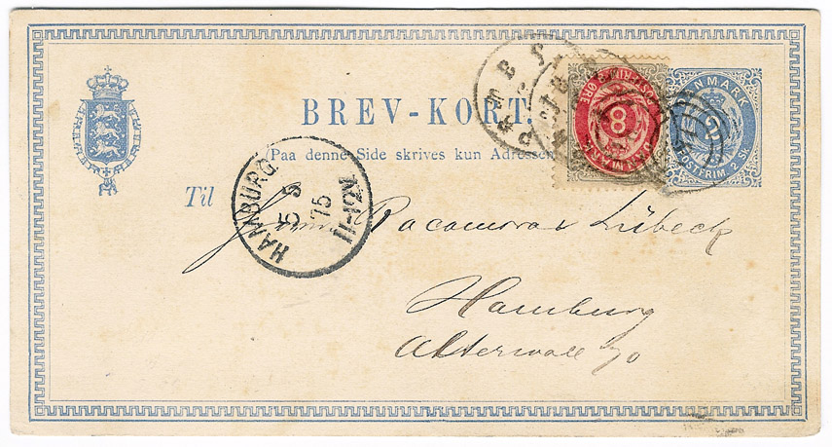
Postal history text (in exhibit focussing on rates):
Pre-UPU postcard sent to Hamburg 05/May/1875. Reduced rates for postcards did not exist pre-UPU. Therefore, all Danish pre-UPU postcards had to be rated as letters: 12 øre to Hamburg 01/Jan/1875-30/Jun/1875. Mixed skilling-øre franking: 8 øre print 2 on 2 skilling stationery postcard.
ONLY RECORDED PRE-UPU POSTCARD SENT IN THE ØRE PERIOD

Slide 28
Postal history text (in exhibit focussing on cancellations):
Item should not be used!
Reasons: the very common ”Combined cancellation 181” is not struck very clearly. It can be found in much better condition!

Slide 29
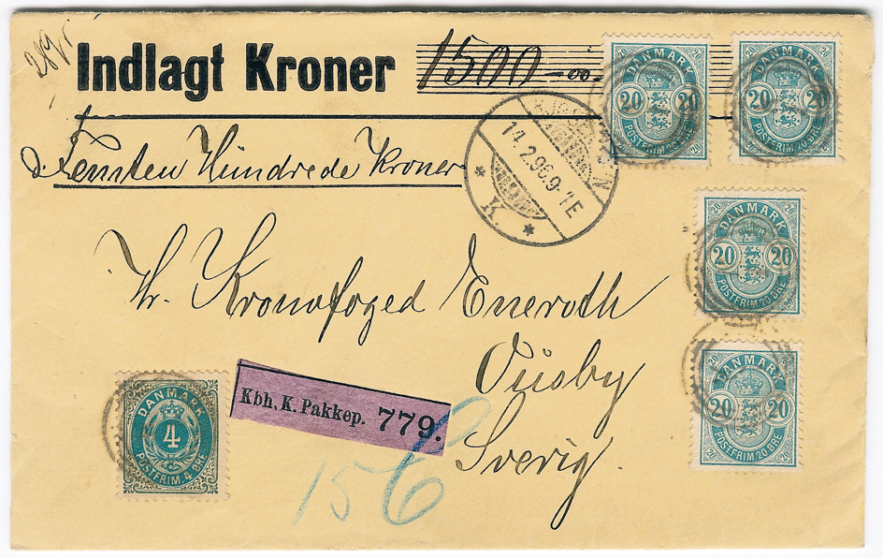
What should a good rate description include?
Insured letter to Sweden sent 14/Feb/1896. Rate: 84 øre.

Slide 30
What should a good rate description include?
Insured letter to Sweden sent 14/Feb/1896. Rate: letter to Sweden 15-125 gram 20 øre + registration fee 16 øre + insurance premium 48 øre for 1250,01-1500 kr = 84 øre.

Slide 31
What should a good rate description include?
Insured letter to Sweden sent 14/Feb/1896. Rate: letter to Sweden 15-125 gram 20 øre + registration fee 16 øre + insurance premium 48 øre for 1250,01-1500 kr = 84 øre 01/Jul/1892-30/Sep/1902.

Slide 32
What should a good rate description include?
Rate: Letter to Sweden 15-125 grams 01/Apr/1885-31/May/1918: 20 øre Registration fee 01/Jan/1875-30/Sep/1902: 16 øre Insurance premium 8 øre per 250 kr 01/Jul/1892-30/Jun/1921 : 48 øre
Total (01/Jul/1892-30/Sep/1902) 84 øre

Slide 33
Questions?

