Slide 1
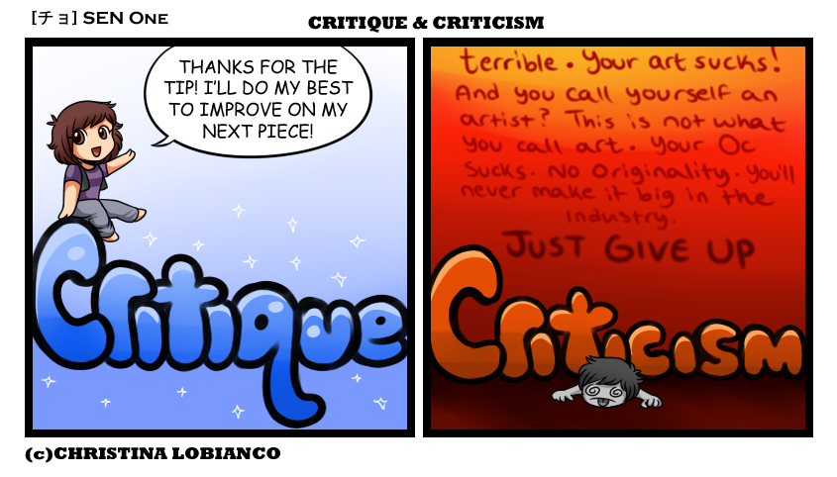
Constructive feedback to the exhibitors
by the FIP Postal History Comission
presented by Henrik Mouritsen
This is one of the most important jobs
of the jury at any FIP show

Slide 2
Why is good feedback important?
The feedback we give will – in many cases – have a strong influence on whether an exhibitor comes home from an exhibition …
… with a feeling that he/she might as well sell his exhibit … => No customer at the next exhibition!
… or …
… with inspiration to improve his/her exhibit and an eagerness to show the results at a later exhibition. => Customer at the next exhibition!
After slide made by Lars Engelbrecht

Slide 3
Why do we give feedback to exhibitors?
To recognise the work the exhibitor has done.
To give the exhibitors helpful advice on how they can improve their exhibit.
To explain the number of points given.
To encourage the exhibitor to work on the exhibit and show it again at future exhibitions.

Slide 4
We do NOT give feedback:
To brag about our own excellence.
To put the exhibitors down.
To show our power (or prejudices) as judges.
To criticise the person in front of us.

Slide 5
How do human beings receive feedback?
Positive feedback
  makes us happy and encourage us to do more of whatever let to the feedback (can decide carriers, hobbies etc.)
  We often forget to give positive feedback!
Negative feedback
  makes us unhappy, discouraged, and is remembered very long
  We often give negative feedback harder than needed!

Slide 6
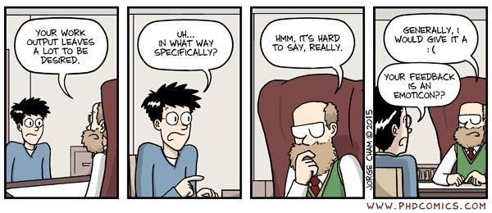
Critique without solutions is useless!
=> We should only mention areas of improvement,
which we have a concrete solution for

Slide 7
Constructive criticism
analyses the problems and suggests solutions
balances positive and negative aspects
is well-prepared
gives only feedback on points, which the exhibitor has a chance to change.
is aware of the economical reality of exhibitor; preferably give >90% of the feedback related to aspects which costs no money to change.

Slide 8
Constructive criticism
makes it clear that it is our personal opinions
makes it clear that it is the exhibitor’s decision whether he/she will change anything. – It is not our exhibit! The exhibitors have the right to do as they please – but we decide on the points!
limits itself to the few most important points, unless the exhibitor actively asks for more.
never develops into a personal attack.

Slide 9
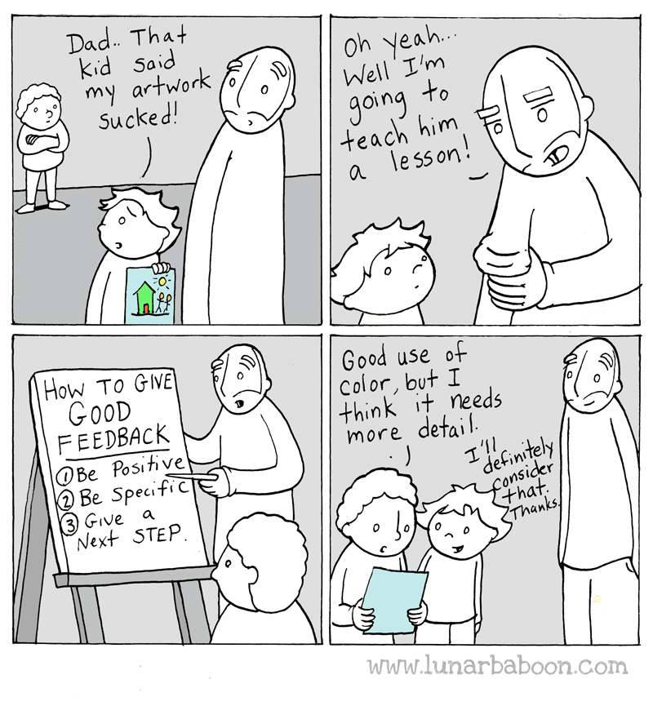

Slide 10
The way that feedback is given is essential for its success or failure

Slide 11
The beginning of the conversation is essential!
We can easily destroy the entire interaction by a confrontational and personal first statement:
  ”You are not allowed to…”
  ”You have to change ...”
  ”You are missing ...”
  ”The reasons you did’t get more points are …”

Slide 12
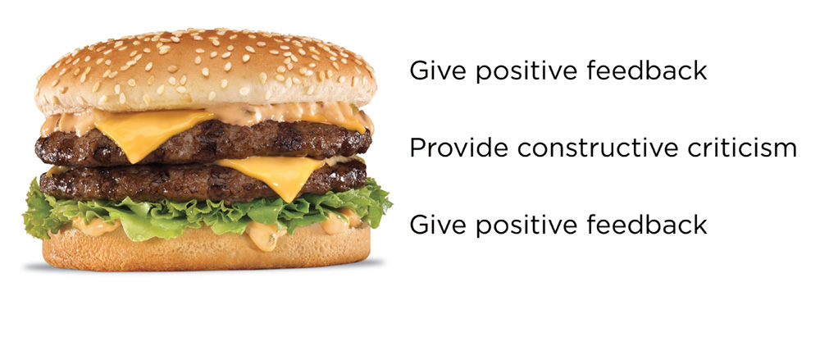
The constructive feedback sandwich

Slide 13
The constructive feedback sandwich
Congratulate and mention positive aspects of the exhibit.
Discuss where the exhibit can be improved and suggest solutions to the challenges.
Encourage the exhibitor by reminding him/her of the positives and that we are looking forward to seeing the exhibit again.

Slide 14
When giving feedback, there will always be several positive aspects
for us to comment upon.
It is our job to find them!

Slide 15
The language of conflicts
Escalating language
You-sentences
Go for the person
Interrupt the speaker
Disinterest (gives the other person the feeling you are not listening to what is being said)
Diffuse statements
Focusing on the past
Focusing on mistakes
Deescalating language
I-sentences
Concentrate on the issue
Do not interrupt the speaker
Interest (gives the other person the feeling you are listening to what is being said)
Concrete statements
Focussing on the present and the future
Focussing on problems and potential solutions
Ask “open” questions
After slide made by Lars Engelbrecht

Slide 16
Step 1: Recognize the positive
Always start out by congratulating the exhibitors with the result and/or thank them for showing the exhibit
(no matter how many points they got)!
Why?
You get the exhibitor’s positive attention and makes it more difficult for the exhibitor to start out the conversation in a negative tone.
You build up self-confidence in the exhibitors and make them more ready to receive constructive critique.
The positive feedback will make the exhibitors feel appreciated and will motivate the exhibitors to continue exhibiting.

Slide 17
A possible structure of the dialogue with the exhibitor
  Welcome
  Information about score sheet (if necessary)
  What are the best aspects of the exhibit (search in the criteria where the exhibit received many points)
  In which areas can the exhibitor improve the most (the criteria where the exhibit received few points)
  Encouragement to show the exhibit again
  Farewell

Slide 18
After having given the first positive feedback, find out whether the exhibitor WANTS feedback!
What are his/her ambitions?

Slide 19
Step 2: Identify problems and their potential solutions
Good constructive feedback subjects:
Focus on important aspects that can be improved without buying additional material (and their consequences for the given scores).

Slide 20
Step 2: Identify problems and their potential solutions
Good constructive feedback subjects:
Focus on important aspects that can be improved without buying additional material (and their consequences for the given scores).
Knowledge and research (35 points):
- Are there factual mistakes?

Slide 21
Step 2: Identify problems and their potential solutions
Good constructive feedback subjects:
Focus on important aspects that can be improved without buying additional material (and their consequences for the given scores).
Knowledge and research (35 points):
- Are there factual mistakes?
- Do the texts provide all pertinent information (e.g.
missing rates, missing print/plating information)?

Slide 22
Step 2: Identify problems and their potential solutions
Good constructive feedback subjects:
Focus on important aspects that can be improved without buying additional material (and their consequences for the given scores).
Knowledge and research (35 points):
- Are there factual mistakes?
- Do the texts provide all pertinent information (e.g.
missing rates, missing print/plating information)?
- Are there knowledge important to the area that are
not shown by the chosen material?

Slide 23
Step 2: Identify problems and their potential solutions
Good constructive feedback subjects:
Treatment (20 points):
- Is the structure easy to follow? (typical helpful advise is to
include a point by point plan on the introductory page and
use corresponding headlines in the top right and left
corners of each page)

Slide 24
Step 2: Identify problems and their potential solutions
Good constructive feedback subjects:
Treatment (20 points):
- Is the structure easy to follow? (typical helpful advise is to
include a point by point plan on the introductory page and
use corresponding headlines in the top right and left
corners of each page)
- Does the title match the content of the exhibit?

Slide 25
Step 2: Identify problems and their potential solutions
Good constructive feedback subjects:
Treatment (20 points):
- Is the structure easy to follow? (typical helpful advise is to
include a point by point plan on the introductory page and
use corresponding headlines in the top right and left
corners of each page)
- Does the title match the content of the exhibit?
- Does the exhibitor open doors he/she does not close?

Slide 26
Step 2: Identify problems and their potential solutions
Good constructive feedback subjects:
Treatment (20 points):
- Is the structure easy to follow? (typical helpful advise is to
include a point by point plan on the introductory page and
use corresponding headlines in the top right and left
corners of each page)
- Does the title match the content of the exhibit?
- Does the exhibitor open doors he/she does not close?
- Is the content balanced considering the subject?

Slide 27
Step 2: Identify problems and their potential solutions
Good constructive feedback subjects:
Condition (10 points):
- Is the common material in top quality?

Slide 28
Step 2: Identify problems and their potential solutions
Good constructive feedback subjects:
Condition (10 points):
- Is the common material in top quality?
Rarity (20 points):
- Could a natural change in the title of the exhibit exclude
parts of the subject, which are not well-covered?

Slide 29
Step 2: Identify problems and their potential solutions
Good constructive feedback subjects:
Condition (10 points):
- Is the common material in top quality?
Rarity (20 points):
- Could a natural change in the title of the exhibit exclude
parts of the subject, which are not well-covered?
Presentation (5 points):
- Are there easy fixes to significantly improve presentation?

Slide 30
Step 2: Identify problems and their potential solutions
Bad constructive feedback subjects:
Presentation (5 points):
- “I found two spelling mistakes on page 34 and 56!”
- “One cover was mounted skewed on page 46 and the cover
on page 10 and 11 are not properly aligned”

Slide 31
Step 2: Identify problems and their potential solutions
Bad constructive feedback subjects:
Presentation (5 points):
- “I found two spelling mistakes on page 34 and 56!”
- “One cover was mounted skewed on page 46 and the cover
on page 10 and 11 are not properly aligned”
Rarity (20 points):
- “You have to buy X, Y, Z!
- “You lack the unique proof and the 100,000 dollar cover
sold at the last Köhler Auction”

Slide 32
Step 2: Identify problems and their potential solutions
Bad constructive feedback subjects:
Importance (10 points):
- “Your exhibit is not that important!”

Slide 33
Step 2: Identify problems and their potential solutions
Bad constructive feedback subjects:
Importance (10 points):
- “Your exhibit is not that important!”
- Bad feedback subject because this can – in most cases –
not be changed!! What is your solution?

Slide 34
Step 2: Identify problems and their potential solutions
Bad constructive feedback subjects:
Importance (10 points):
- “Your exhibit is not that important!”
- Bad feedback subject because this can – in most cases –
not be changed What is your solution?
Any minor point not likely to substantially change
the score of the exhibit

Slide 35
Step 3: End the conversation with encouragement
Maybe reiterate the positive points.
Say: “Once again congratulation with the result!”
“I am looking forward to seeing your exhibit soon, what about showing it at exhibition XYZ?

Slide 36
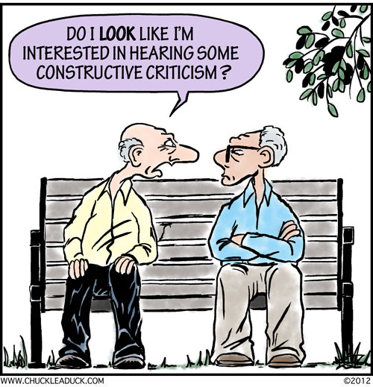
We might not be able to win them all
But we can work on “winning” over as many as possible

Slide 37
Open Discussion among the participants

